Slide 1
Image Attribute Classification using Disentangled Embeddings on Multimodal Data
Introduction
Many visual domains (housing, vehicle surroundings) require mapping images to the attributes they contain.
Goal
Represent images as disentangled attribute vectors.
For example, the first k dimensions of an image embedding could represent tree, the next k could represent house etc.
Applications
Verify attributes of houses based on images. For example, we could use this model to answer the question: do renters’ homes really have the attributes (ie. hardwood floors, closets, etc) that they claim to have?
Another example lies in the space of autonomous driving.
We can find attributes of images that contain a cars’ surroundings.

Slide 2
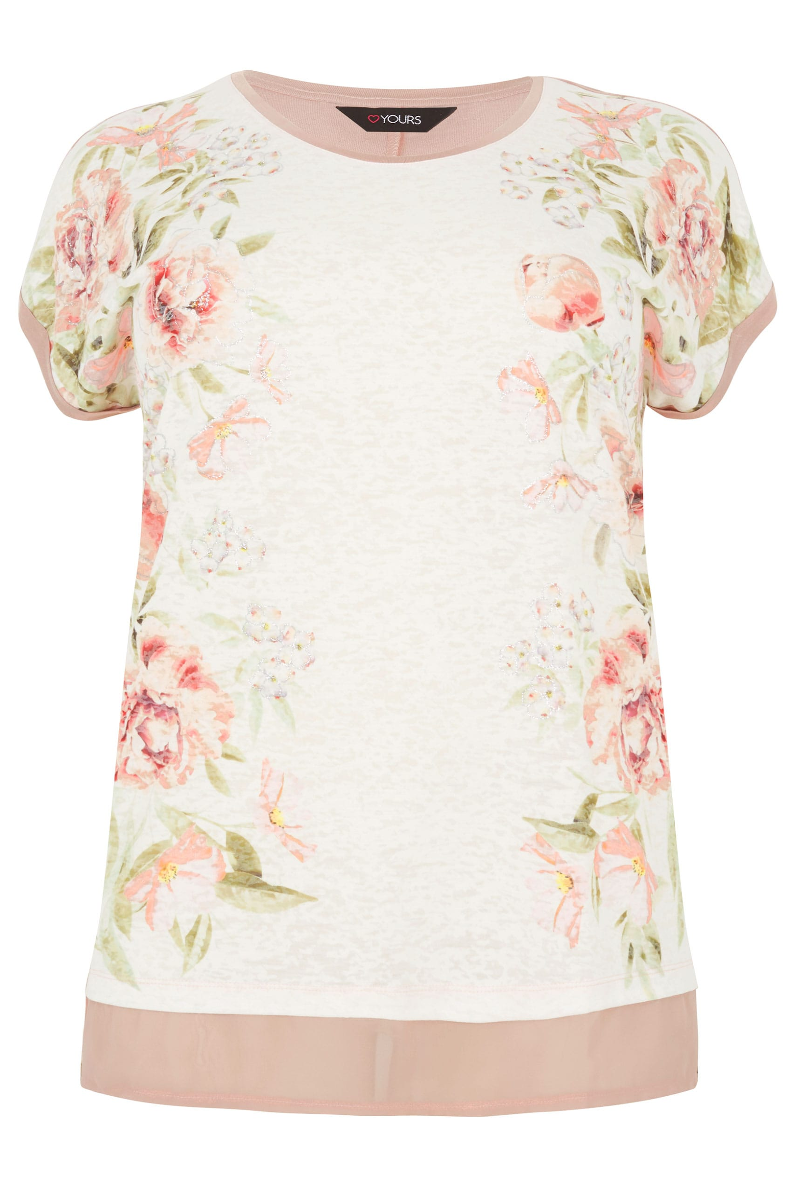
Generating Disentangled Embeddings
Attribute
Train
CorrNet
Matrices_color
Color
Style
Apparel Type
“pink”
Train
CorrNet
Matrices_style
Matrices_concat
Matrices_final
“floral”
Train Final
CorrNet
Initialize Final CorrNet
“pink floral top”
Train
CorrNet
Matrices_type
“top”

Slide 3
Research Areas/Extensions
When considering a large number of attributes, many images may not contain all of these attributes.
For example, in a housing domain, if our attribute space consists of “bed”, “lamp” and “dresser”, one particular image may only have a “bed” and a “lamp”.
We can explore what value for the text component we would give the CorrNet for an image (a bedroom) where the attribute is not present (no dresser)
Ideas: we could use a vector of 0’s, or use vector orthogonal to the attribute that is not contained in the image.
Can we feed in (attribute, image) pairs and the whole image, or can we experiment with image segmentation and feed in (attribute, segmented image) -- which performs better?

